Slide 1
IOT BASED UNDERGROUND CABLE FAULT DETECTION
By:
Sayana Moni Gayathri

Slide 2
Contents:
Introduction
Block Diagram
Hardware Requirements
Software Requirements
Flow Chart
Circuit Diagram
Applications
Advantages and Disadvantages
Output
Future Scope
Conclusion

Slide 3
Introduction:
Underground cables are prone to wide variety of faults due to underground conditions.
So here we propose a cable fault detection over IOT that detects the exact fault position over IOT that makes repairing work very easy.

Slide 4
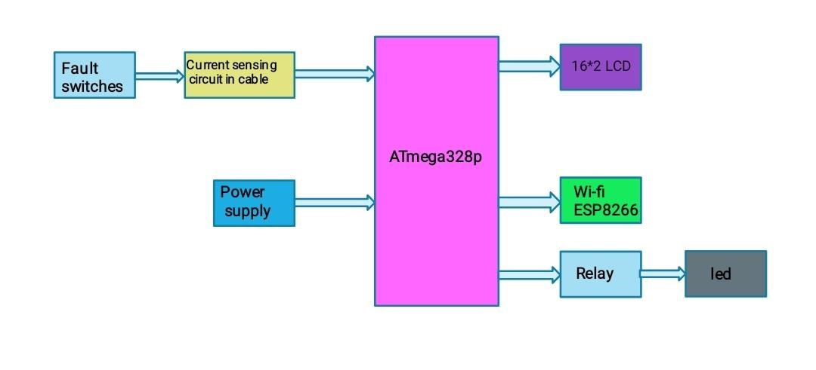
Block Diagram:

Slide 5
Hardware Requirements:
Microcontroller(Atmega-328p)
Wi-fi Module(ESP8266)
Relay
LCD Display
Connectors
Regulator
PCB
LED
Transformer/Adapter
Push Button
Rectifier
Power Supply

Slide 6
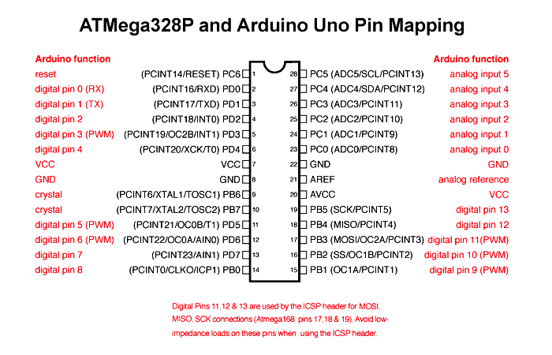
ATMega328P

Slide 7
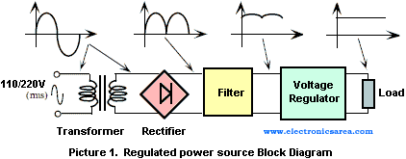
Power Supply:
All digital circuits requires regulated power supply

Slide 8
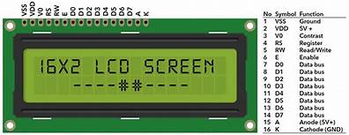
Liquid Crystal Display(LCD):
LCD is very helpful in providing user interface as well as for debugging purpose. The most common type of LCD controller is HITACHI 44780 which provides a simple interface between the controller & an LCD.
These LCD's are very simple to interface with the controller as well as are cost effective.

Slide 9
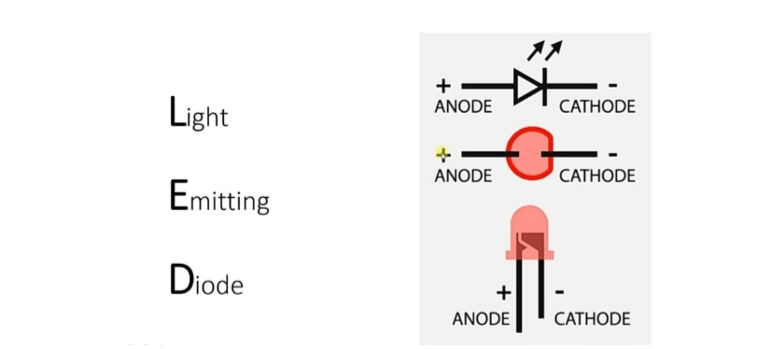
LED:
A Light-emitting Diode is a semiconductor light source that emits light when current flows through it.
This directional lighting capability reduces wasted light and energy.

Slide 10
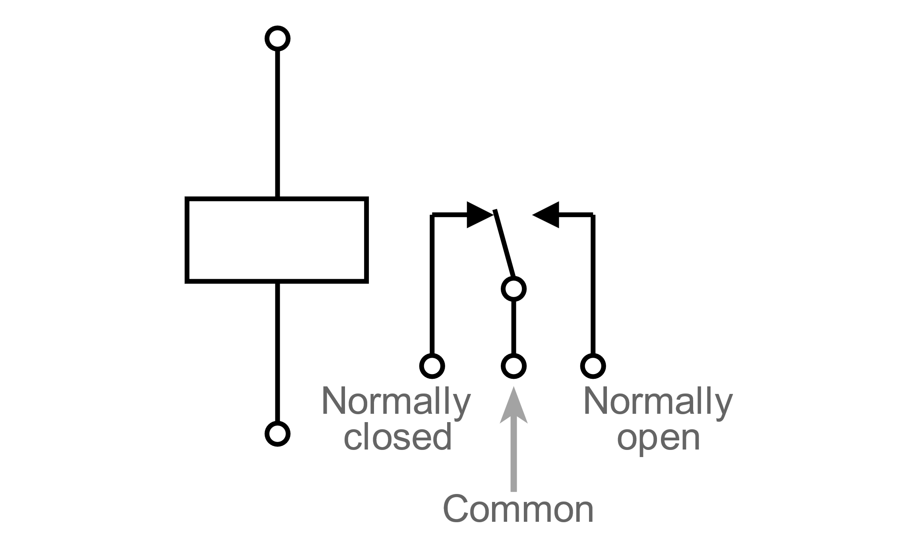
Relay:
The switch contacts on a relay can be "normally open" (NO) or "normally closed" (NC)-that is, when the coil is at rest and not energized (no current flowing through it), the switch contacts are given the designation of being NO or NC.

Slide 11
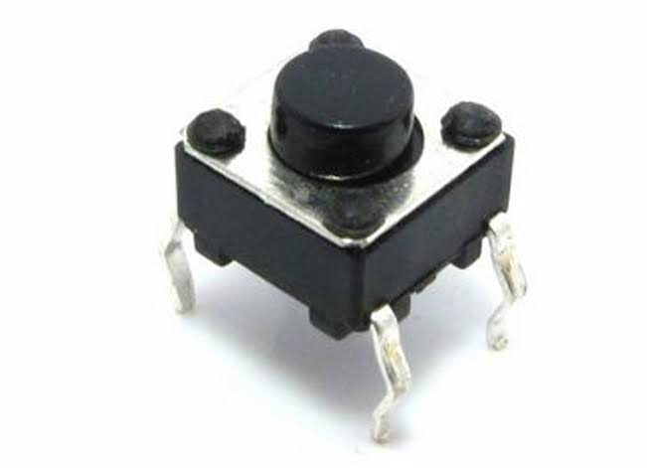
Push Button
The push button switch is usually used to turn on and off the control circuit
It is kind of control switch appliance that is widely used.

Slide 12
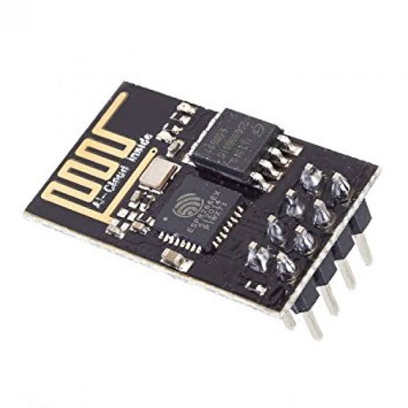
Wi-fi Module(ESP 8266):
Features:
Low cost, compact and powerful Wi-Fi Module
Power Supply:+3.3V only
Supports serial communication
Can be programmed using Arduino IDE

Slide 13
Software requirements:
Arduino IDE
Micro Controller Programming Language: C

Slide 14
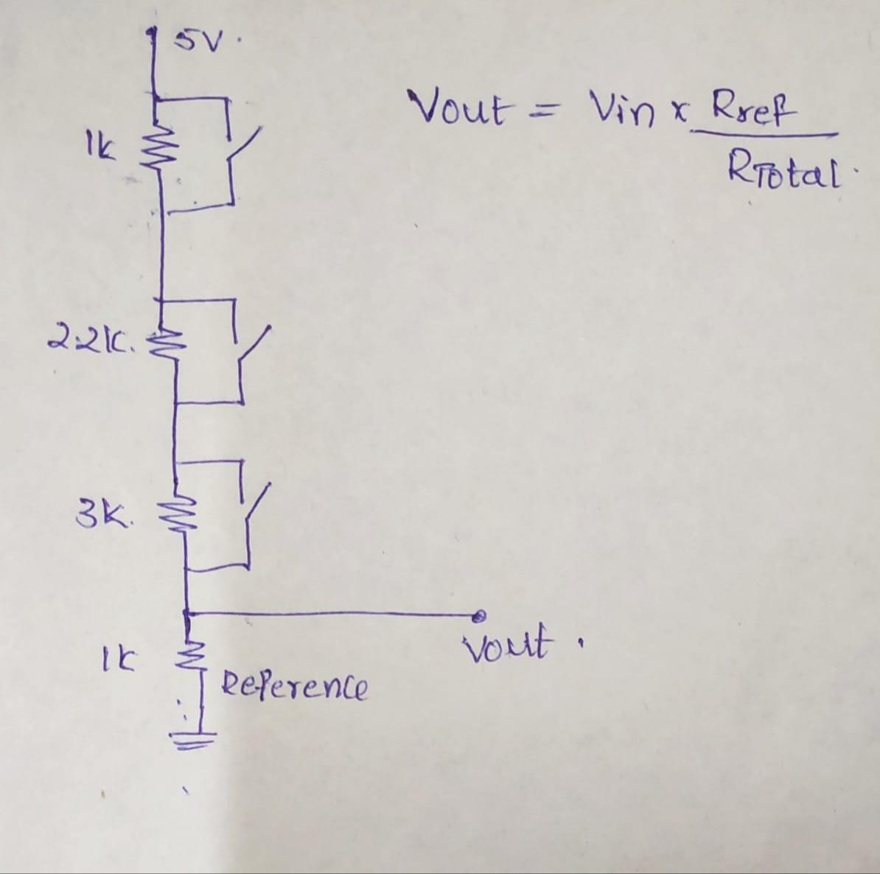
Flow Chart:
START
INITIALIZE LCD &WIFI MODULE
Voltage Divider Network
SWITCH ON/OFF
VOLTAGE IS CREATED & GIVE TO A0 PIN OF ARDUINO
CALL AND READ ADC FUNCTION
BASED ON VOLTAGE VALUE, DISTANCE IN KM IS OBTAINED
DISPLAY LOCATION OF FAULT IN LCD
DISPLAY OF INFORMATION IN WEBPAGE
STOP

Slide 15
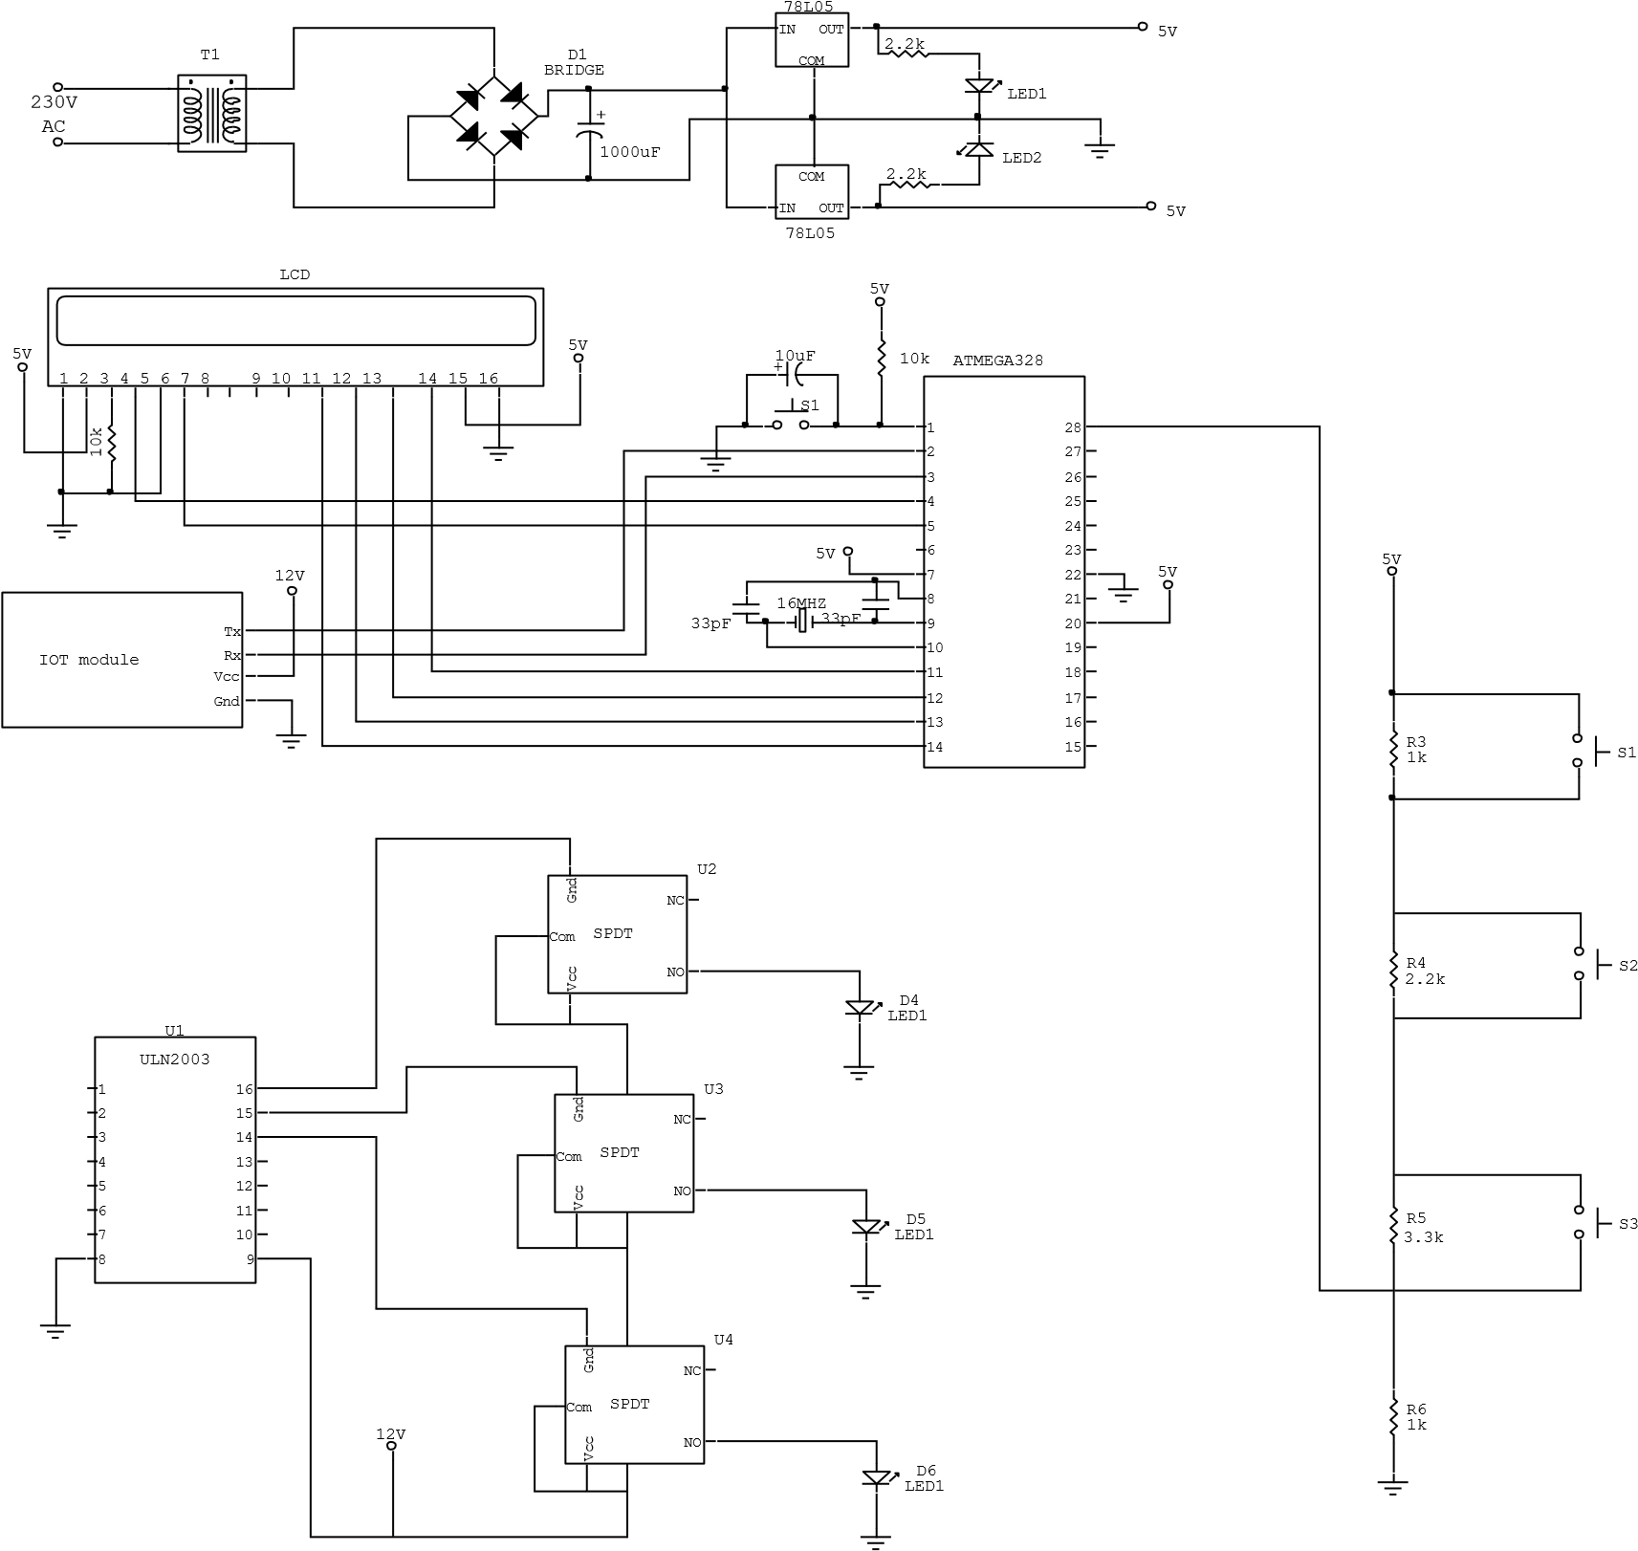
Circuit Diagram:

Slide 16
Applications:
Industrial Application.
Ground Cable fault detection application.
Electrical cable fault detection.

Slide 17
Advantages and Disadvantages:
Advantages:
The main use of this project is to determine the underground cable fault.
Low cost.
Less complexity.
Long distance application.
Disadvantages:
This has insulation problem at high voltage.
The Arduino and other components require 5v DC supply.

Slide 18
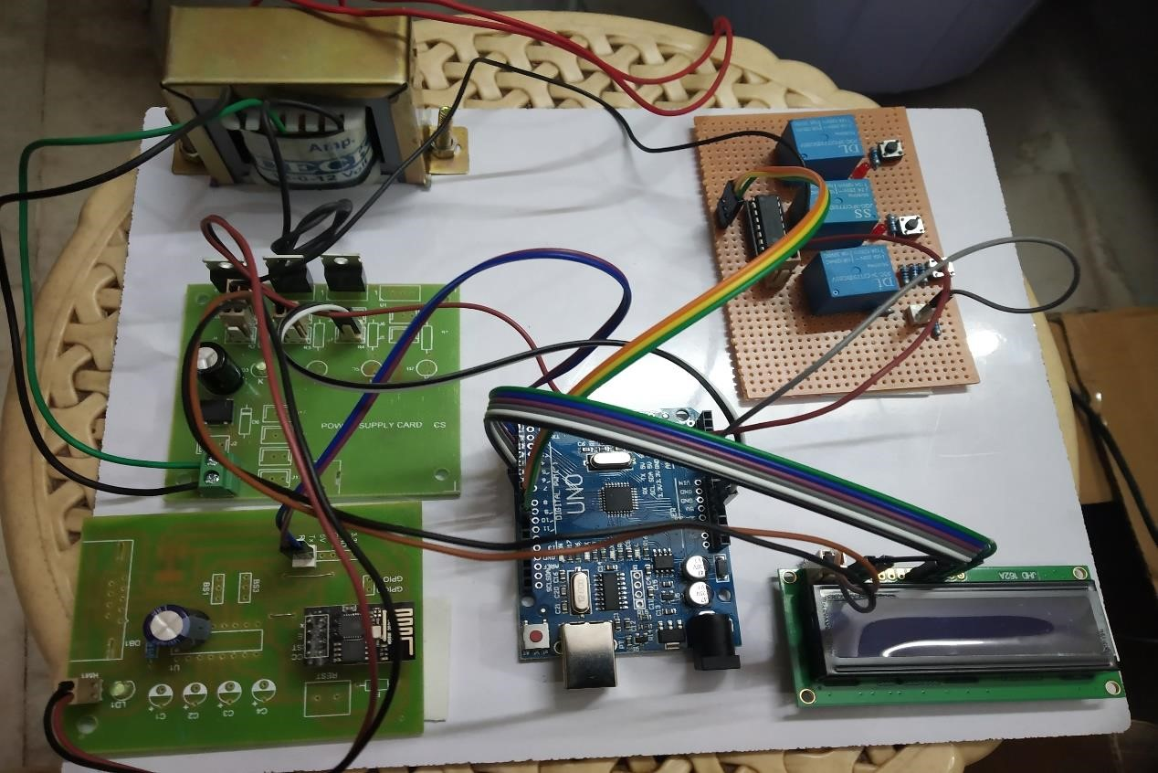
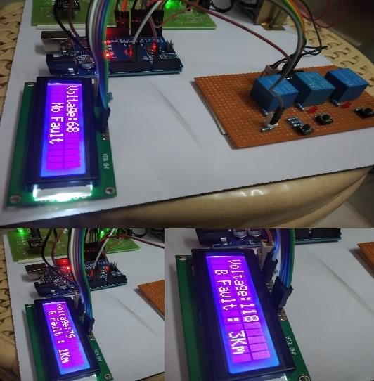
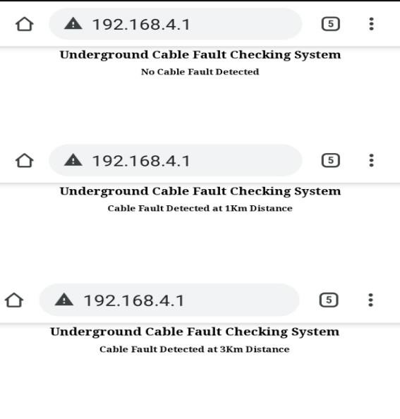
Output

Slide 19
Future Scope:
We can further develop a better user interface by which detection of open circuit fault is possible in near future. To find the fault in ac circuits, fluctuation in impedance is measured with the help of capacitor. In this way we can find the fault distance.

Slide 20
Conclusion:
The project “ IOT based Underground Cable fault detection” has been successfully designed and tested by Integrating features of all the hardware components and by developing the model.
Presence of every module, reasoning out them and placing carefully can contribute to best work.
Finally by using highly advanced IC’s and with the help of growing technology the project has been successfully implemented.

Slide 21
References:
ARM-systemonchip-architecture by Steve furber.
ARM-user manual UM10114.
ARM System Developers Guide by Andrew N.SLOSS
"Power Electronics” by M D Singh and K B Khanchandan
"Linear Integrated Circuits” by D Roy Choudary & Shail Jain
"Electrical Machines” by S K Bhattacharya
"Electrical Machines II” by B L Thereja
www.8051freeprojectsinfo.com

Slide 22

THANK YOU

